Slide 1
Bringing Livewire to Drupal
Component-based dynamic interfaces
twitter.com/hugronaphor
drupal.org/u/hugronaphor
linkedin.com/in/cornelandreev
Cornel Andreev / cornel.co

Slide 2
Prelude

Slide 3
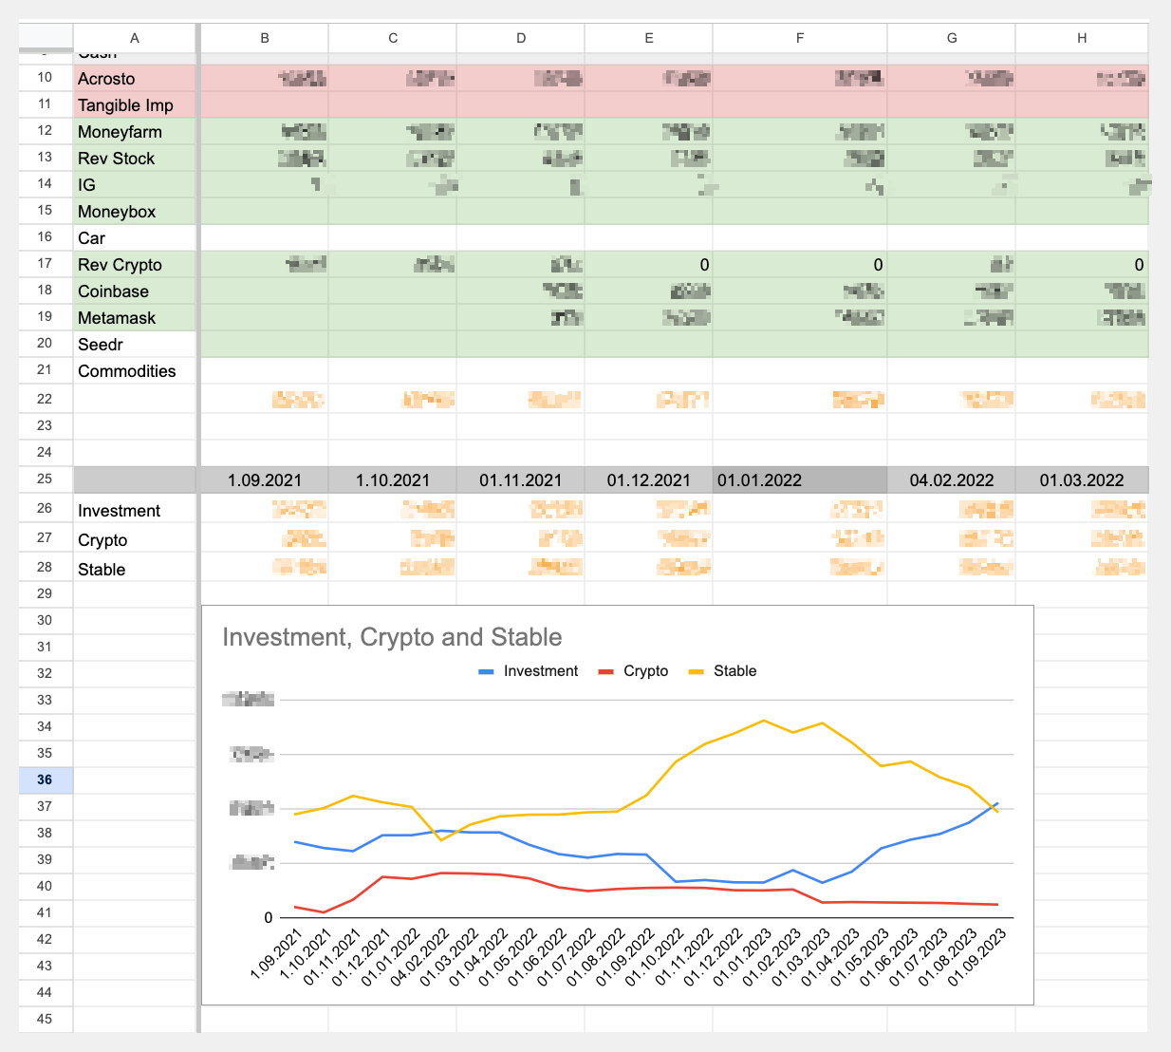

Slide 4
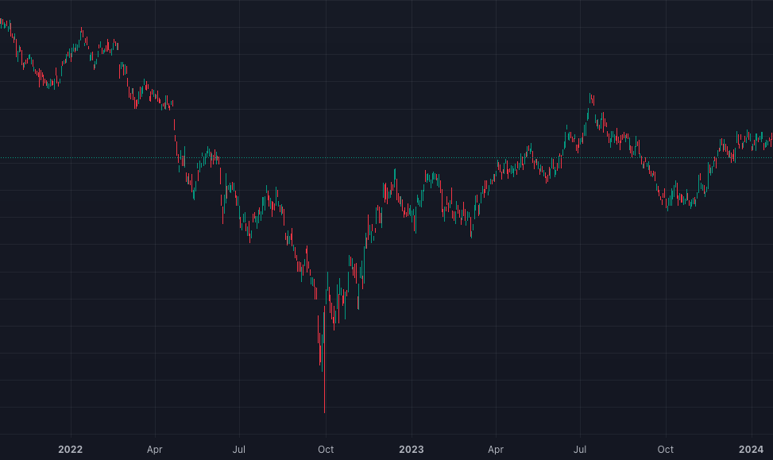
The £ has fallen sharply against everything

Slide 5
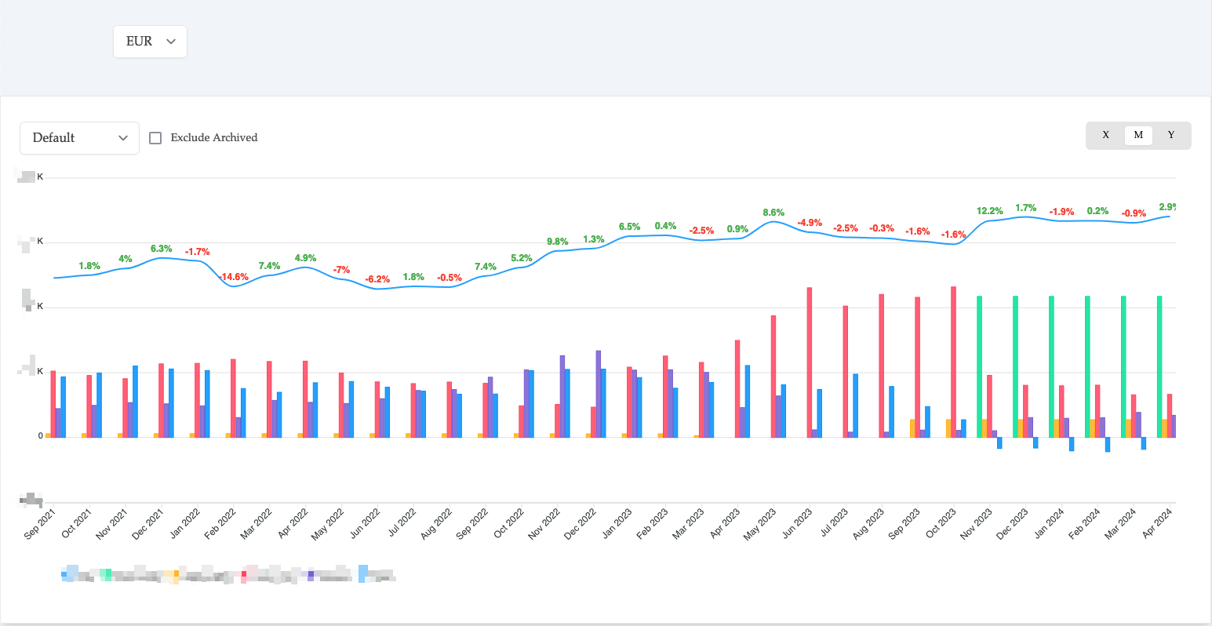
Performance chart

Slide 6
namespace Drupal\hello_ajax\Controller;
use Drupal\Core\Controller\ControllerBase;
use Drupal\Core\Render\RendererInterface;
use Symfony\Component\DependencyInjection\ContainerInterface;
use Symfony\Component\HttpFoundation\JsonResponse;
/**
* Json response for Ajax route.
*/
class HelloAjaxController extends ControllerBase {
protected ?RendererInterface $renderer;
public function __construct(RendererInterface $renderer) {
$this->renderer = $renderer;
}
public static function create(ContainerInterface $container) {
return new static(
$container->get('renderer')
);
}
public function createHelloAjaxResponse(): JsonResponse {
$time = [
'#markup' => $this->t('My items: @items', [
'@items' => '...',
]),
];
$response['items'] = $this->renderer->render($time);
return new JsonResponse($response);
}
}
(function ($, Drupal) {
'use strict';
/**
* Replaces content response from Ajax call.
*/
Drupal.behaviors.replaceMyContent = {
attach: function () {
$.ajax({
url: Drupal.url(‘my-url'),
type: 'POST',
dataType: 'json',
success: function (response) {
if (response.hasOwnProperty('items')) {
$(“.content-to-replace”)
.text(response.time);
}
}
});
}
};
})(jQuery, Drupal);

Slide 7
@calebporzio

Slide 9
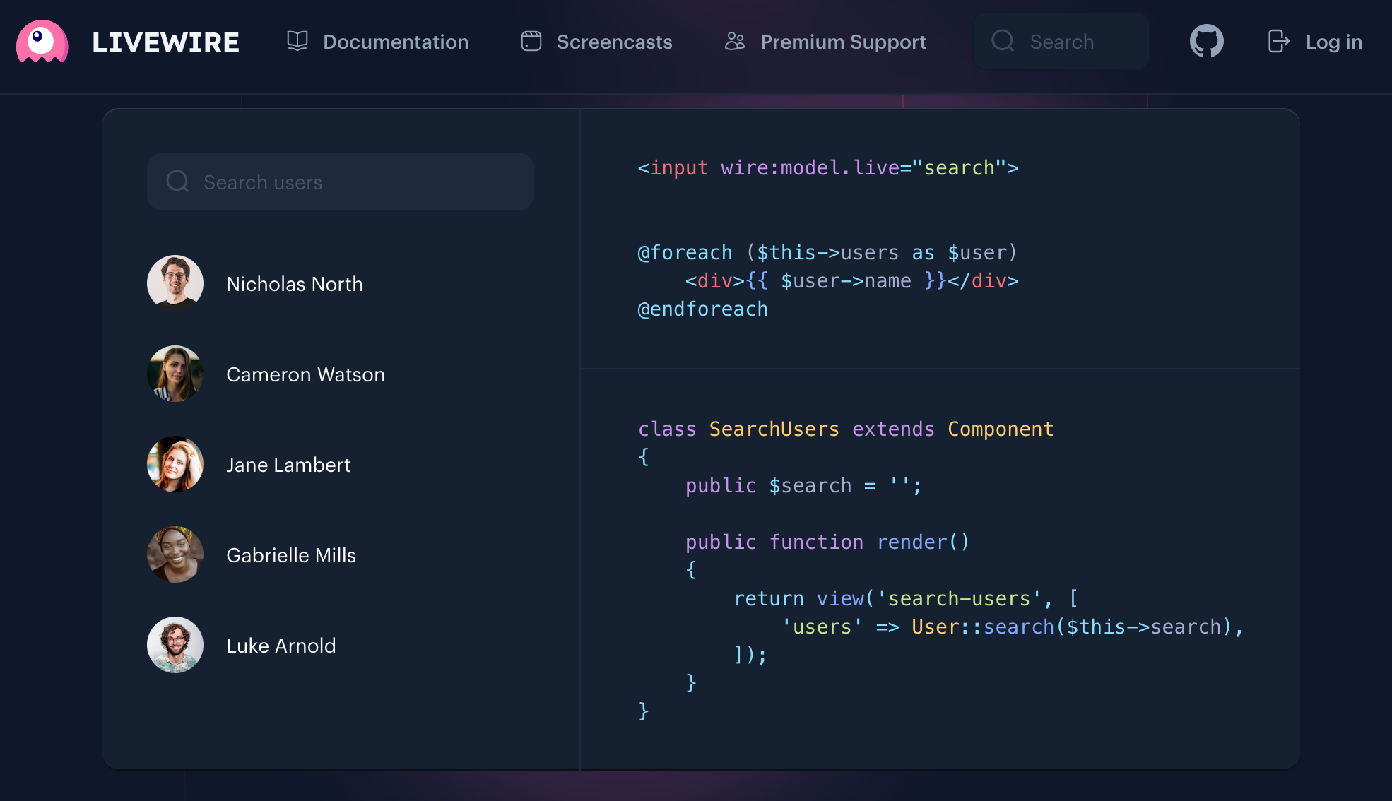

Slide 10
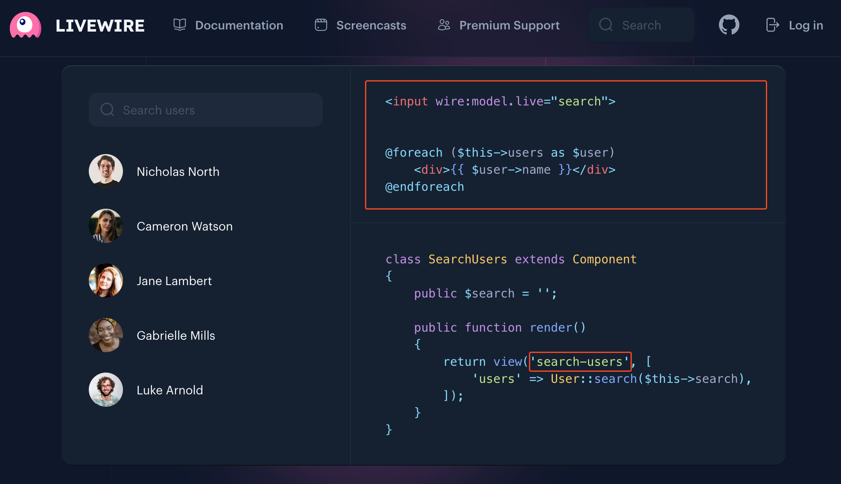

Slide 11
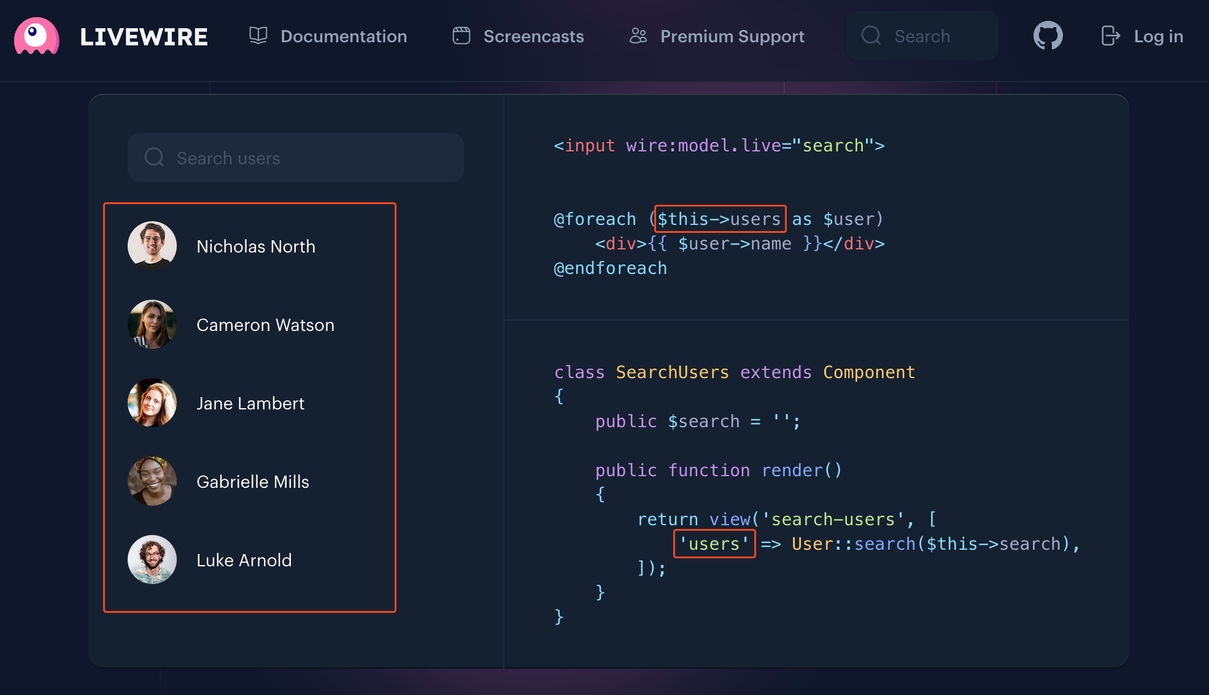

Slide 12
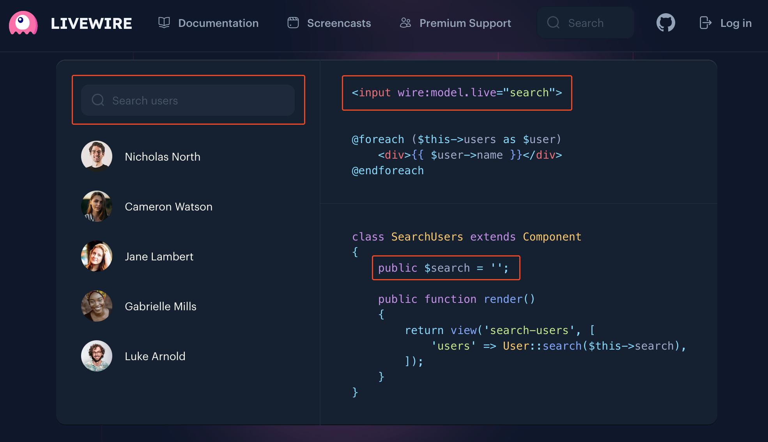

Slide 13
Livewire is not unique
( in a good way )

Slide 20
Basics

Slide 21
…/drupalcamp/src/Plugin/WireComponent/Counter.php
…/drupalcamp/templates/wire/counter.html.twig
namespace Drupal\drupalcamp\Plugin\WireComponent;
use Drupal\wire\View;
use Drupal\wire\WireComponent;
/**
* @WireComponent(
* id = "counter",
* label = @Translation("Counter component"),
* )
*/
class Counter extends WireComponent {
public int $count = 0;
public function render(): ?View {
return View::fromTpl(‘counter');
}
}
<div>
<p>{{ count }}</p>
</div>

Slide 22
…/drupalcamp/src/Plugin/WireComponent/Counter.php
…/drupalcamp/templates/wire/counter.html.twig
namespace Drupal\drupalcamp\Plugin\WireComponent;
use Drupal\wire\View;
use Drupal\wire\WireComponent;
/**
* @WireComponent(
* id = "counter",
* label = @Translation("Counter component"),
* )
*/
class Counter extends WireComponent {
public int $count = 0;
public function render(): ?View {
return View::fromTpl(‘counter');
}
}
<div>
<p>{{ count }}</p>
</div>

Slide 23
…/drupalcamp/src/Plugin/WireComponent/Counter.php
…/drupalcamp/templates/wire/counter.html.twig
namespace Drupal\drupalcamp\Plugin\WireComponent;
use Drupal\wire\View;
use Drupal\wire\WireComponent;
/**
* @WireComponent(
* id = "counter",
* label = @Translation("Counter component"),
* )
*/
class Counter extends WireComponent {
public int $count = 0;
public function render(): ?View {
return View::fromTpl(‘counter');
}
}
<div>
<p>{{ count }}</p>
</div>

Slide 24
<div>
{{ wire('counter') }}
…
</div>
https://wire-drupal.com/docs/rendering-components
$wire_counter_component = [
'#type' => 'wire',
'#id' => ‘counter',
];

Slide 25
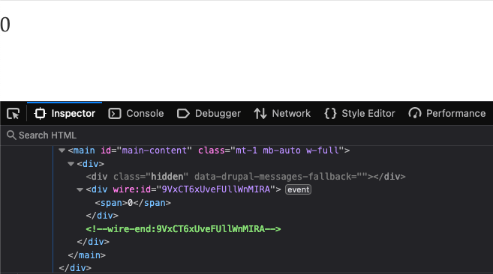

Slide 27
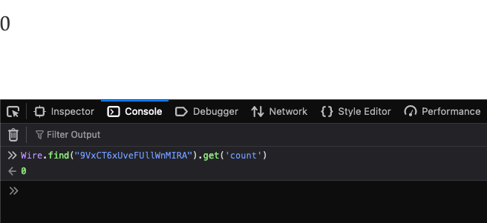

Slide 28
Actions
wire:[dispatched browser event]="[action]"

Slide 29
<button wire:click="doSomething">Do Something</button>
<input wire:keydown.enter=“doSomething">
<form wire:submit.prevent="save">
...
<button>Save</button>
</form>
<button wire:whatever_custom_event=“doSomething"></button>
<button wire:click="changeTitle('a string', '{{ random() }}')">
Change Title to a random one
</button>

Slide 30
<button wire:click="doSomething">Do Something</button>
<input wire:keydown.enter=“doSomething">
<form wire:submit.prevent="save">
...
<button>Save</button>
</form>
<button wire:whatever_custom_event=“doSomething"></button>
<button wire:click="changeTitle('a string', '{{ random() }}')">
Change Title to a random one
</button>

Slide 31
<button wire:click="doSomething">Do Something</button>
<input wire:keydown.enter=“doSomething">
<form wire:submit.prevent="save">
...
<button>Save</button>
</form>
<button wire:whatever_custom_event=“doSomething"></button>
<button wire:click="changeTitle('a string', '{{ random() }}')">
Change Title to a random one
</button>

Slide 32
<button wire:click="doSomething">Do Something</button>
<input wire:keydown.enter=“doSomething">
<form wire:submit.prevent="save">
...
<button>Save</button>
</form>
<button wire:whatever_custom_event=“doSomething"></button>
<button wire:click="changeTitle('a string', '{{ random() }}')">
Change Title to a random one
</button>

Slide 33
<button wire:click="doSomething">Do Something</button>
<input wire:keydown.enter=“doSomething">
<form wire:submit.prevent="save">
...
<button>Save</button>
</form>
<button wire:whatever_custom_event=“doSomething"></button>
<button wire:click="changeTitle('a string', '{{ random() }}')">
Change Title to a random one
</button>

Slide 34
<button wire:click="doSomething">Do Something</button>
<input wire:keydown.enter=“doSomething">
<form wire:submit.prevent="save">
...
<button>Save</button>
</form>
<button wire:whatever_custom_event=“doSomething"></button>
<button wire:click="changeTitle('a string', '{{ random() }}')">
Change Title to a random one
</button>

Slide 35
…/drupalcamp/src/Plugin/WireComponent/Counter.php
…/drupalcamp/templates/wire/counter.html.twig
namespace Drupal\drupalcamp\Plugin\WireComponent;
use Drupal\wire\View;
use Drupal\wire\WireComponent;
/**
* @WireComponent(
* id = "counter",
* label = @Translation("Demo counter component"),
* )
*/
class Counter extends WireComponent {
public int $count = 0;
public function render(): ?View {
return View::fromTpl(‘counter');
}
}
<div>
<p>{{ count }}</p>
</div>

Slide 36
class Counter extends WireComponent {
public int $count = 0;
public function render(): ?View {
return View::fromTpl(‘counter');
}
}
<div>
<p>{{ count }}</p>
</div>

Slide 37
class Counter extends WireComponent {
public int $count = 0;
public function increment(): void {
$this->count++;
}
public function render(): ?View {
return View::fromTpl('counter');
}
}
<div>
<span wire:click="increment">+</span>
<p>{{ count }}</p>
</div>

Slide 38
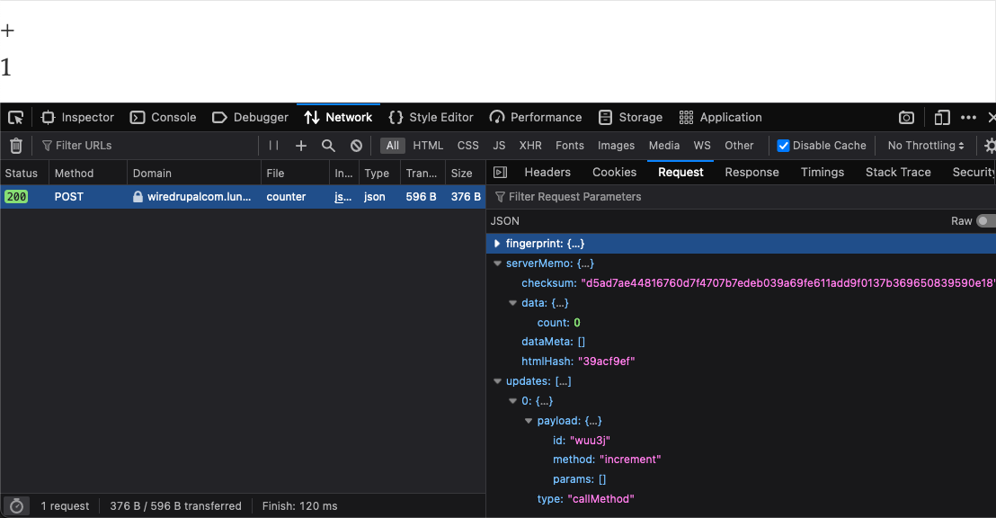

Slide 39
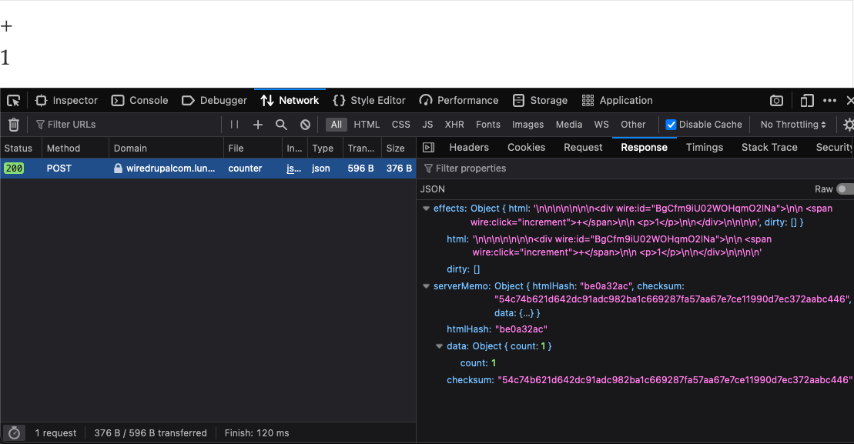

Slide 40
class Counter extends WireComponent {
public int $count = 0;
public function decrement(): void {
$this->count--;
}
public function increment(): void {
$this->count++;
}
public function render(): ?View {
return View::fromTpl('counter');
}
}
<div>
<span wire:click="decrement">-</span>
<span wire:click="increment">+</span>
<p>{{ count }}</p>
</div>

Slide 41
class Counter extends WireComponent {
public int $count = 0;
public function decrement(int $by): void {
$this->count = $this->count - $by;
}
public function increment(): void {
$this->count++;
}
public function render(): ?View {
return View::fromTpl('counter');
}
}
<div>
<span wire:click=“decrement(2)”>-</span>
<span wire:click="increment">+</span>
<p>{{ count }}</p>
</div>

Slide 42
wire-drupal.com
Cornel Andreev
cornel.co
twitter.com/hugronaphor
drupal.org/u/hugronaphor
linkedin.com/in/cornelandreev

